Slide 1
Side panel labels

Slide 2
Back side
Top panel
Ø90 mm
Ø3.55”
Left side
Right side
Bottom panel
Ø90 mm
Ø3.55”
Front side
Fan bolt holes: Ø4.5 mm, Ø0.177”, #16

Slide 3
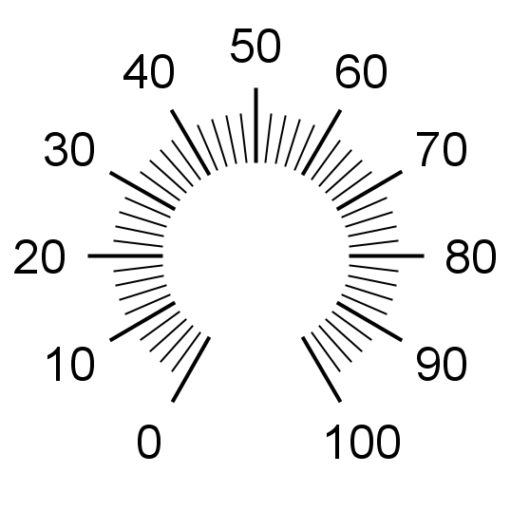
Four-channel MHz LED Driver
https://github.com/Llamero/Four_Channel_MHz_LED_Driver
Sync
1
2
3
4
Manual
LED Channel
LED intensity
Potentiometer: 6.6 mm, 17/64” #G
Potentiometer Key: 1.7 mm, 5/64”, #51
Pushbutton: 9 mm, 23/64”, #T
Toggle Switch: 5 mm, 13/64”, #8

Slide 4

USB
12V DC
1.5A min
4 3 2 1
Analog/
Digital
Inputs
I X I2C
I2C,
External
Analog,
Current
Sense
X 3 2 1
Sync Output,
External
Therm
4 3 2 1
LED
Output
USB: 18 mm, 23/32”
USB bolts: 3.4 mm, 9/64”, #29
DC jack: 15 mm,
Potentiometer Key: 1.7 mm, 5/64”, #51
Pushbutton: 9 mm, 23/64”, #T
Toggle Switch: 5 mm, 19/32”

